Slide 1
MINRMS: an efficient algorithm for determining protein structure similarity using root-mean-squared-distance
Andrew I. Jewett, Conrad C. Huang and Thomas E. Ferrin
BIOINFORMATICS Vol. 19 no. 5 2003, pages 625–634

Slide 2

ABSTRACT
Motivation: Existing algorithms for automated protein structure alignment generate contradictory results and are difficult to interpret. An algorithm which can provide a context for interpreting the alignment and uses a simple method to characterize protein structure similarity is needed.
Results: We describe a heuristic for limiting the search space for structure alignment comparisons between two proteins, and an algorithm for finding minimal root-mean-squared- distance (RMSD) alignments as a function of the number of matching residue pairs within this limited search space. Our alignment algorithm uses coordinates of alphacarbon atoms to represent each amino acid residue and requires a total computation time of , where m and n denote the lengths of the protein sequences.

Slide 3
ABSTRACT
This makes our method fast enough for comparisons of moderatesize proteins (fewer than ∼800 residues) on current workstation-class computers and therefore addresses the need for a systematic analysis of multiple plausible shape similarities between two proteins using a widely accepted comparison metric.

Slide 4

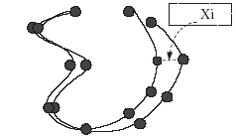
RMSD (Root Mean Square Deviation)

Slide 5

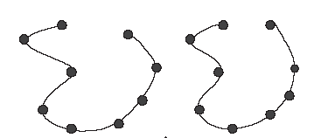
RMSD (Root Mean Square Distance)
A B

Slide 6
Basic Algorithm
(1) generate the set of initial superpositions to evaluate;
(2) for each candidate superposition of the two molecules, identify the minimal RMSD alignments;
(3) optimize the superposition of the molecules based on the best alignments obtained in step two.

Slide 7
Sampling Superposition Space
To generate the set of candidate superpositions, we superpose all fragments of four consecutive residues from one structure onto all fragments of four consecutive residues from the second structure.
To superpose the two fragments, we use Diamond’s method (Diamond, 1988) to align the alpha-carbon atoms from each of the four pairs of residues.
The number of superpositions that need to be evaluated is (n − 4) × (m − 4)

Slide 8
Identifying Matching Residue Pairs
To compute the residue equivalences, we use a dynamic programming algorithm similar to the algorithm by Needleman and Wunsch (1970).
Let denote the minimum possible sum-squared-distance between N pairs of matched residues, considering only the first i residues from structure A, and the first j residues from structure B.

Slide 9


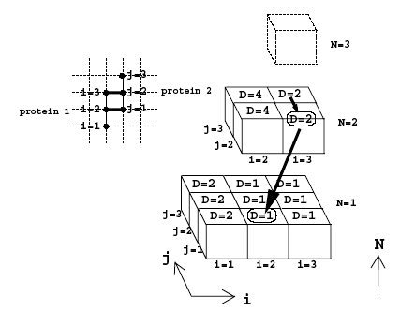


Slide 10
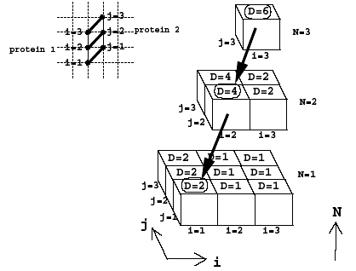
The lowest layer represents the score matrix for matching only one pair of residues; each layer above represents the score matrix for matching an additional residue pair and is computed using the data from the layer below

Slide 11
Let denote the minimum possible sum-squared-distance between N pairs of matched residues, considering only the first i residues from structure A, and the first j residues from structure B.
The minimum RMSD of any alignment containing N pairs of matched residues at this superposition is then

Slide 12
Complexity analysis
two structures : n and m residues(m ≤ n)
match pairs : N ≤ m
total complexity of our algorithm is

